Slide 1
Nakuja Internship Week 4 Progress Report
IAN KIBANDI

Slide 2
Tasks completed last week
Assembled the launchpad
Research on writing to flash memory on esp32
Research on Engine mount
Propellant casting
Static firing test

Slide 3
Tasks to complete this week
Continue casting propellant and firing tests.
Assemble the engine mount.
Model the motor bracket.
Research on payload camera.

Slide 4
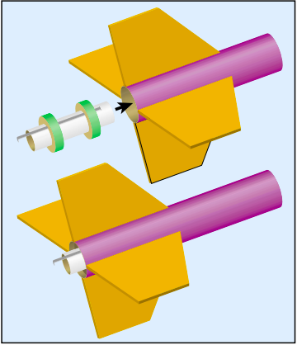
ENGINE MOUNT

Slide 5
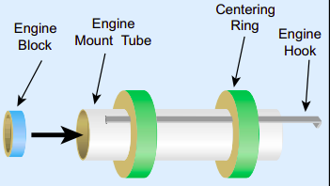
Ignition PCB

Slide 7
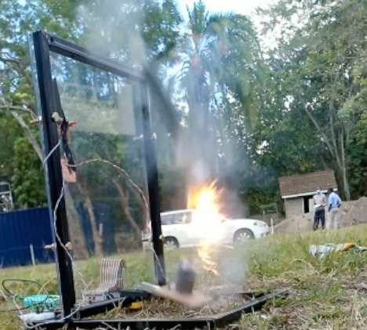

Slide 8
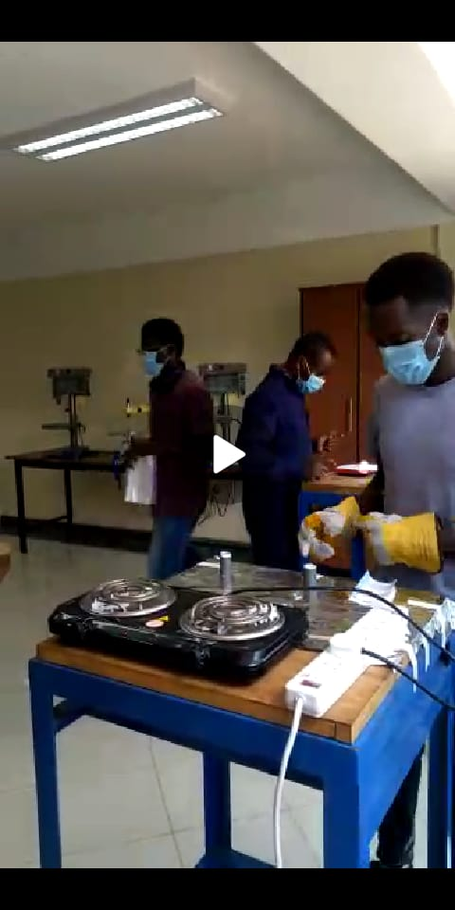

Slide 9
Timeline
Month | Week | Tasks
March | Week1 | Design and fabrication of nozzle
 | Week2 | Design and fabrication of test stand
 | Week3 | Casting propellant
 | Week4 | Testing the model rocket on motor
April | Week1 | Avionics bay development
 | Week2 | Integration and testing with avionics
 | Week3 | Integration and testin with propulsion
 | Week4 | Launch of N-1 rocket

